Slide 1

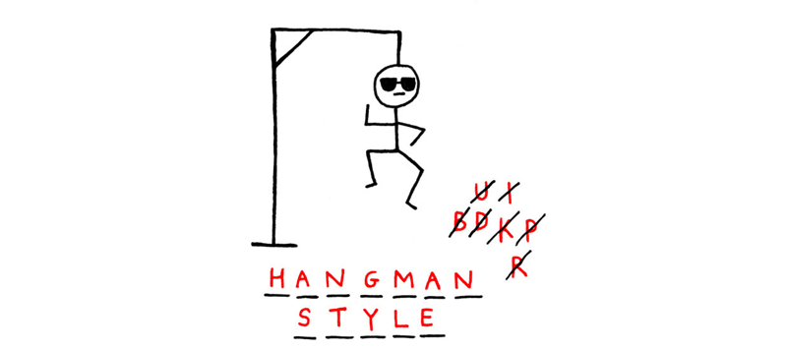
Hangman in Python
Philène Moquette

Slide 2
Description Hangman
Rules:
Player gets 10 tries to guess a randomly selected secret word
The player gets to guess either one letter each turn or, if they’re feeling lucky, they can attempt to guess the whole word. However:
If they guess the word wrong, it’s Game Over.
If the 10 turns run out before the player guesses the word, it’s Game Over.
If the player guesses the word correctly or guesses all letters before the 10 turns are over, they win!

Slide 3
Challenges
The obvious:
I still feel like I don’t know what I’m doing a lot of the time

